Slide 1

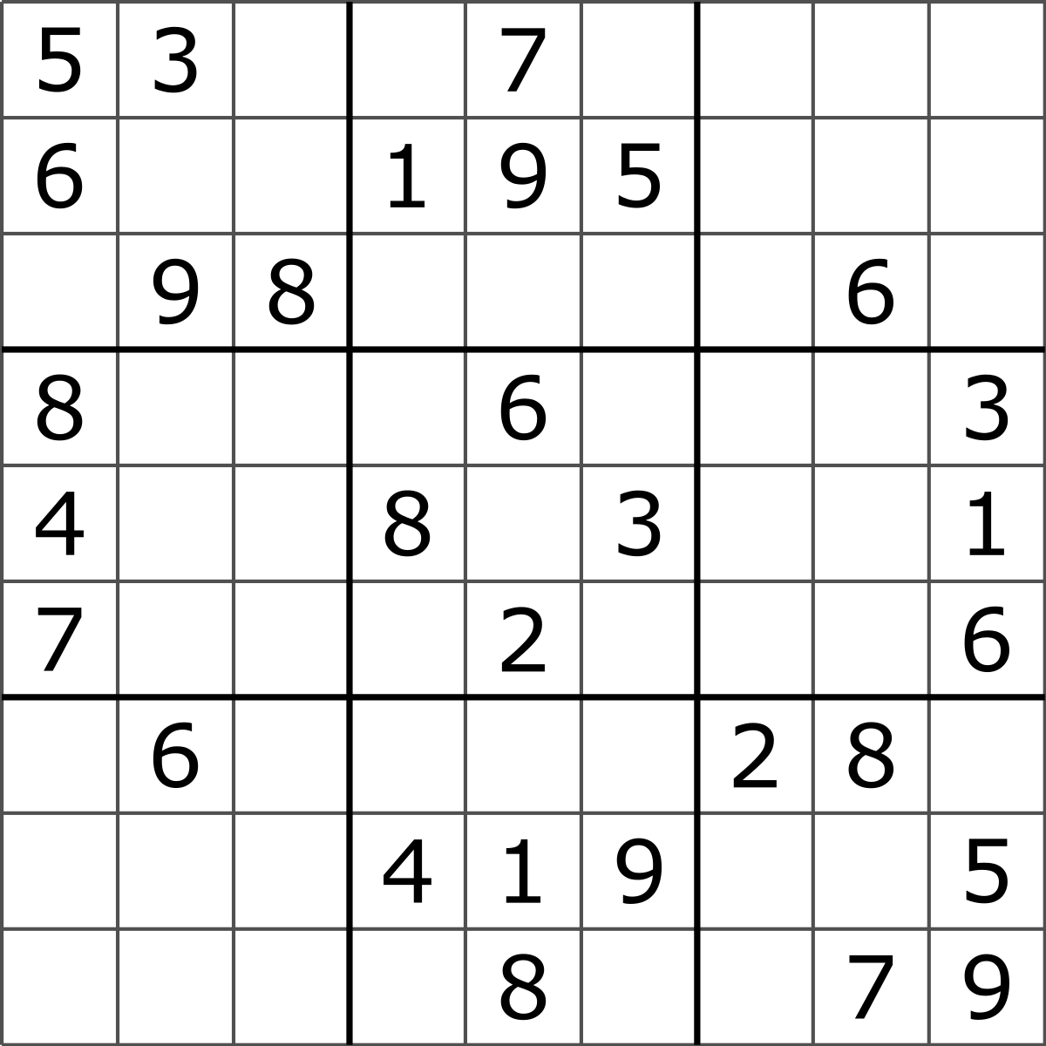



Can Large Language Models (LLMs) Reason?
Download PPTX Slides
?
?
?
Asim Munawar
x.com/asimunawar
linkedin.com/in/asimmunawar

Slide 2
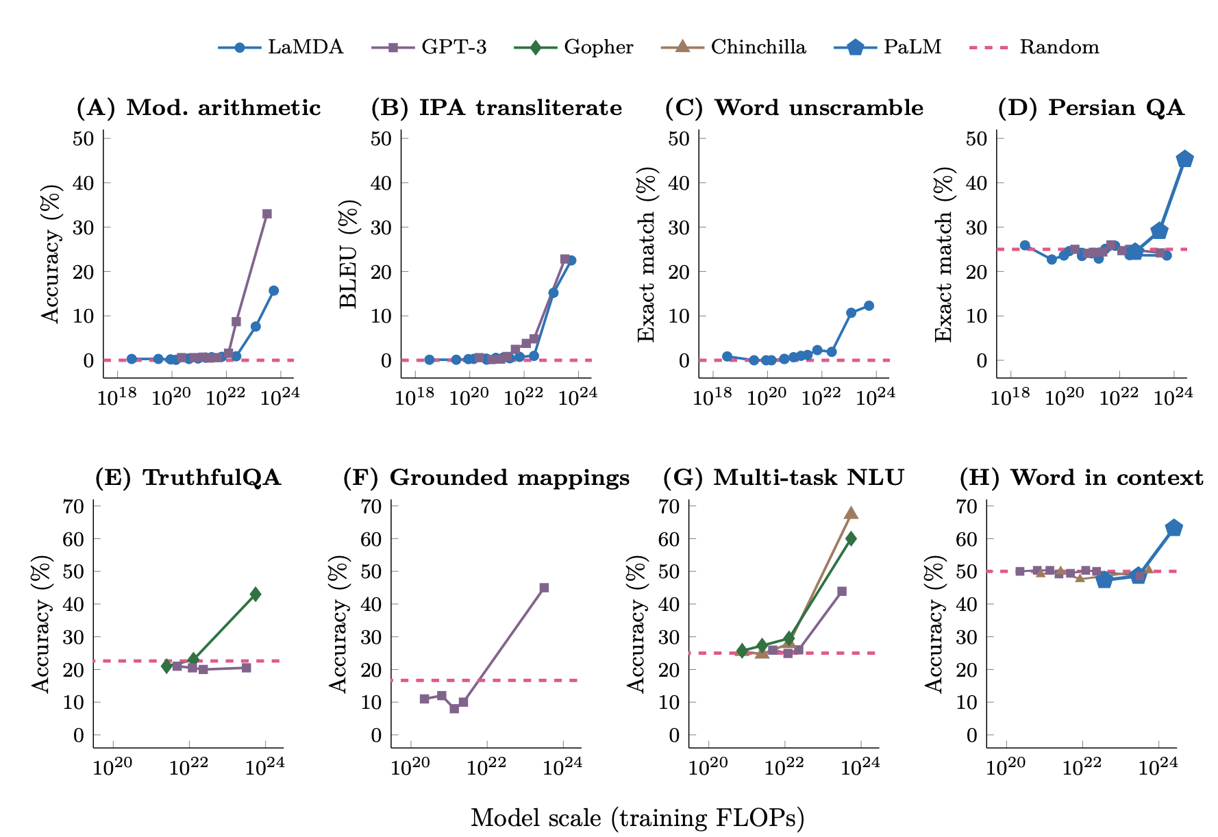
Emergent abilities of LLMs
An ability is emergent if it is not present in smaller models but is present in larger models
Size of a model depends on
Training FLOPs
Number of model parameters
Training data size
Reasoning is an emergent property of LLMs
Emergent Abilities of Large Language Models
Jason Wei et al.
Notes:
Source: https://youtu.be/0Z1ZwY2K2-M?t=207

Slide 3
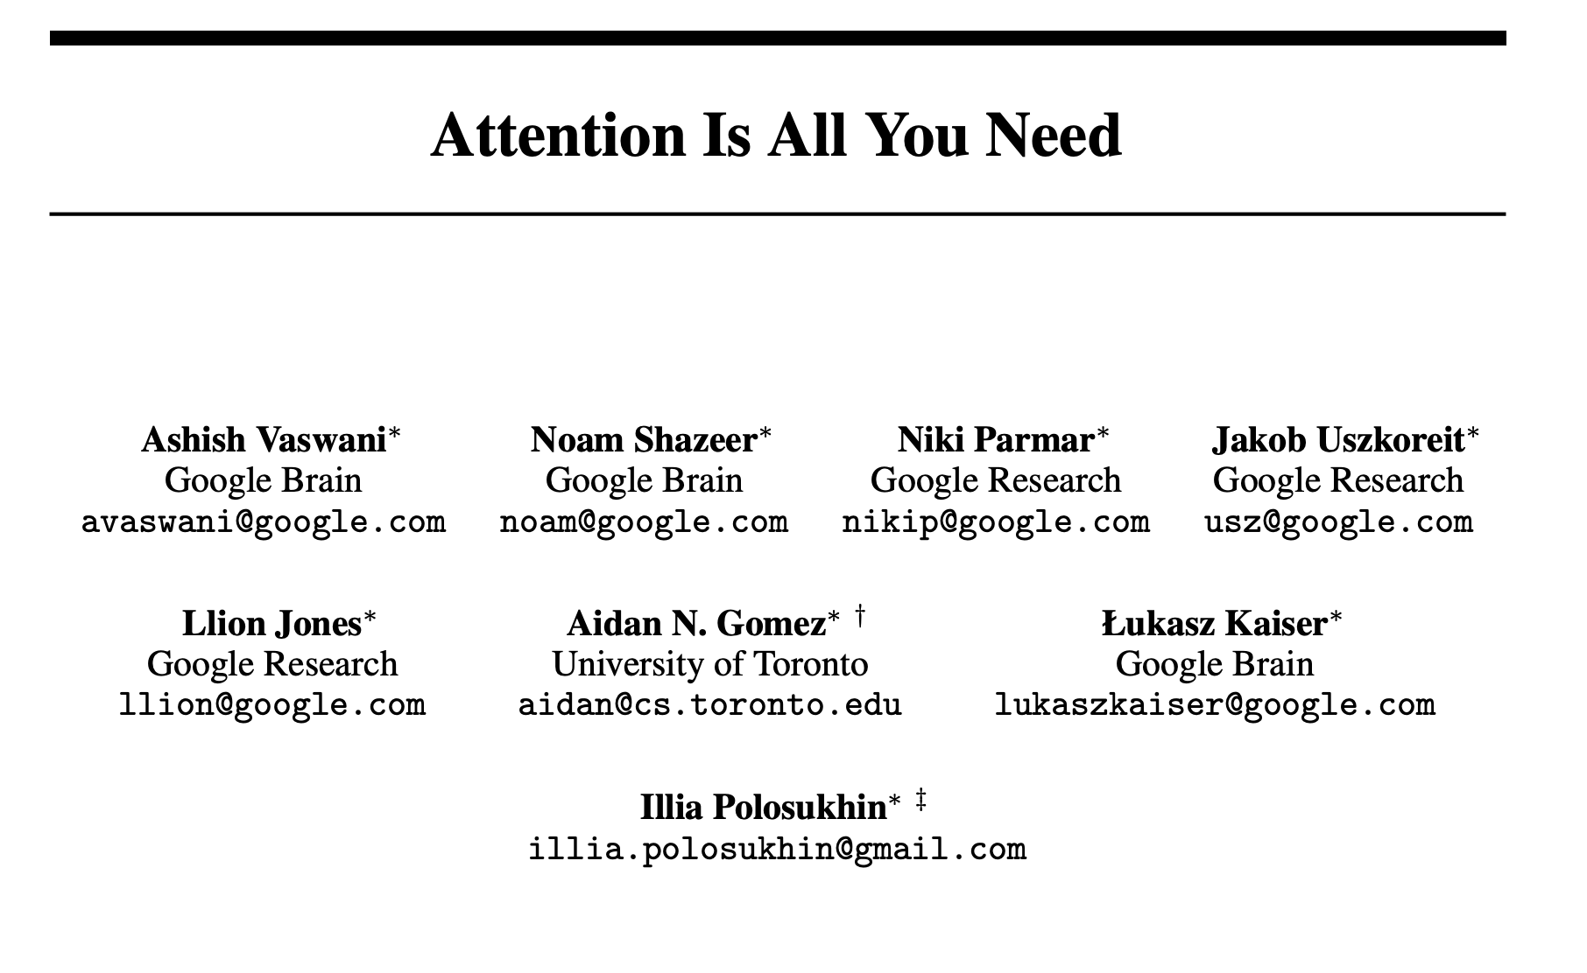
Transformer Architecture
Almost all the famous Large Language Models (LLMs) are based on Transformers Architecture
Published in 2017
https://arxiv.org/abs/1706.03762

Slide 4
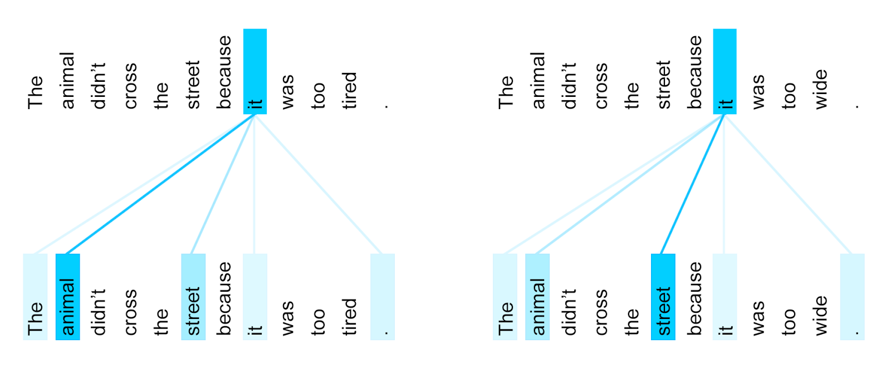
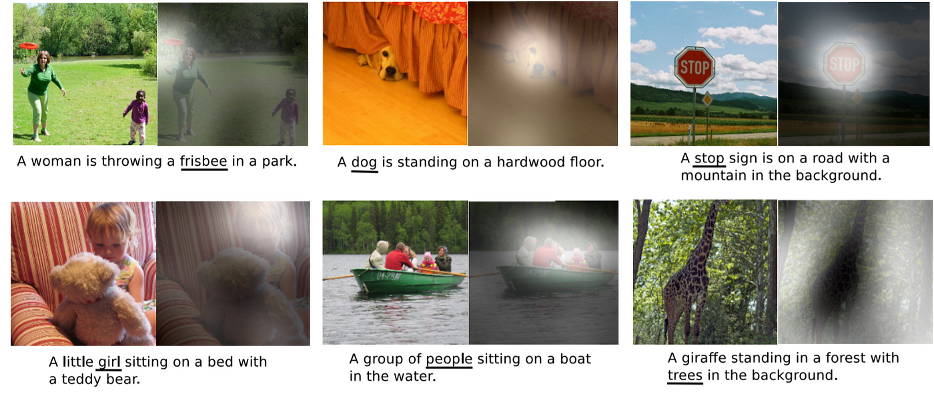
Attention
The attention allows models to focus on specific parts of input data while making predictions or generating outputs
Image source: Uszkoreit (2017)
Image source: Xu et al. (2015)
Encoder self-attention distribution for the word 'it' in different contexts.
Notes:
Uszkoreit, Jakob. 2017. "Transformer: A Novel Neural Network Architecture for Language Understanding." Google AI Blog, August 31. Accessed 2019-11-14.

Slide 5
Transformer Architecture
Tokyo
Next Word
Numeric Encoding
Decoder
Encoder
Input
Target
What is the capital of Japan?
<Start>

Slide 6

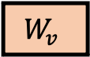
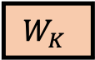
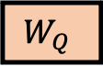
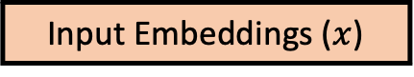
Self Attention
Key | Value
Name | Asim Munawar
Employer | IBM
Address | New Jersey
… | …
Tokyo
Next Word
Intuitive explanation
Q:Query is the query/question (e.g., what is the full name?)
K:Key is the label (e.g., name field in a form)
V:Value is the actual string under the label (e.g., Asim Munawar)
Numeric Encoding
Decoder
Encoder
$$W_{Q}$$
$$W_{K}$$
$$W_{v}$$
Input
Target
What is the capital of Japan?
<Start>
Input Embeddings ($x$)

Slide 7
Reasoning with Large Language Models (LMMs)

Slide 8
What is Reasoning?
Reasoning is the process of thinking about something in a logical and systematic way, using evidence and past experiences to reach a conclusion or make a decision.
Notes:
Reasoning involves making inferences, evaluating arguments, and drawing logical conclusions based on available information.
How can a language model reason? The authors define reasoning in the context of LLMs as the following: Reasoning is decomposing a potentially complex task into simpler subtasks the LM can solve more easily by itself or using tools. There exist various ways to decompose into subtasks, such as recursion or iteration.
https://www.shaped.ai/blog/do-large-language-models-llms-reason#:~:text=How%20can%20a%20language%20model,such%20as%20recursion%20or%20iteration.

Slide 9
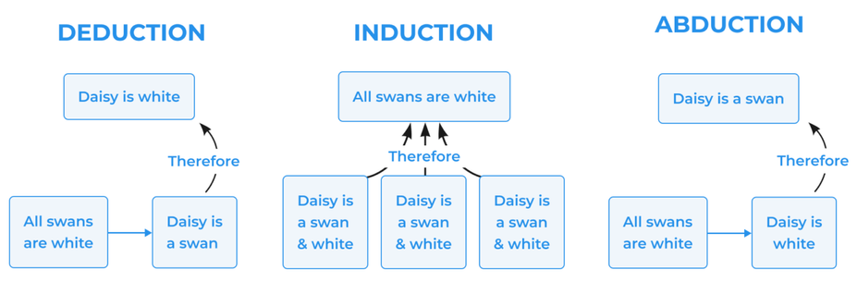
What is Reasoning?
Reasoning is the process of thinking about something in a logical and systematic way, using evidence and past experiences to reach a conclusion or make a decision.
Source: https://mconsultingprep.com/what-is-deductive-reasoning
Notes:
Reasoning involves making inferences, evaluating arguments, and drawing logical conclusions based on available information.
How can a language model reason? The authors define reasoning in the context of LLMs as the following: Reasoning is decomposing a potentially complex task into simpler subtasks the LM can solve more easily by itself or using tools. There exist various ways to decompose into subtasks, such as recursion or iteration.
https://www.shaped.ai/blog/do-large-language-models-llms-reason#:~:text=How%20can%20a%20language%20model,such%20as%20recursion%20or%20iteration.

Slide 10
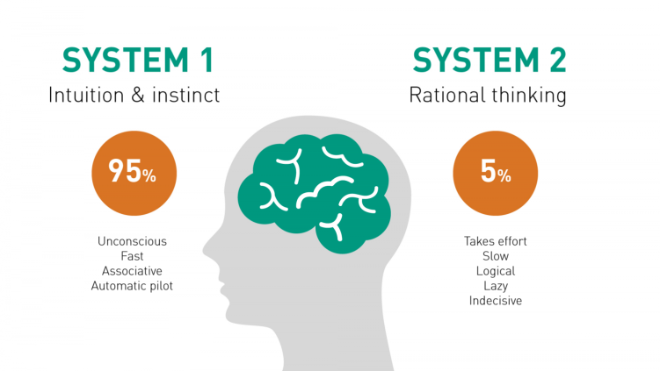
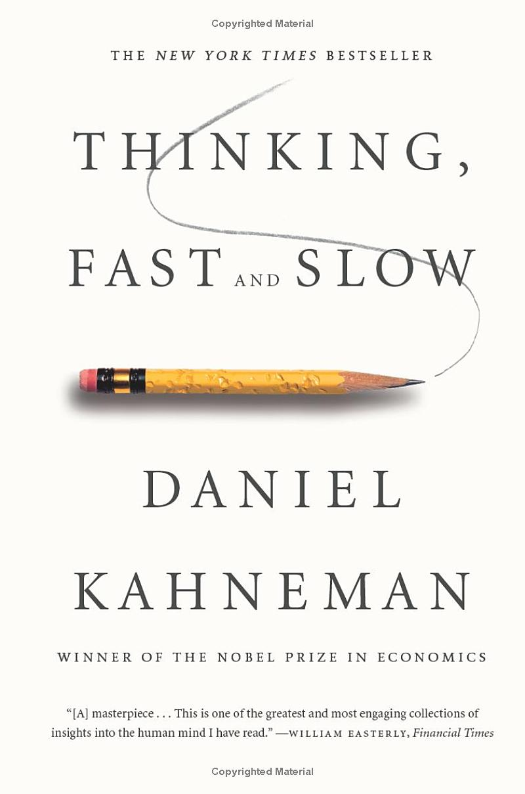
Thinking Fast and Slow
Thinking Fast
Can do things like 2+2=?
Recognized objects in images
Thinking slow
Can reason about solving complex problems – planning complex tasks
Alternative Terms
Data-driven vs. knowledge driven
Symbolic vs. sub-symbolic
Neuro-symbolic
Plan a vacation …
Source: https://www.linkedin.com/pulse/brain-system-1-2-faraz-ehjaz/
Notes:
System 1 and System 2
The psychologist Daniel Kahenman popularized two kinds of thinking: System 1 and System 2. Yan LeCun and others have been very clear. If deep neural networks are doing anything like reasoning at all, it’s strictly System 1. That’s not an intuitive judgement, either, the research bears this out. Deep neural networks are not doing symbolic reasoning (a little louder for the breathless folks in the back).
System 1: Fast, Automatic Reasoning
Automatic: Processes information automatically without conscious control.
Fast: Decisions and assessments are made quickly.
Heuristic-based: Often relies on rules of thumb, mental shortcuts, or stereotypes.
Emotion-driven: Emotions and gut feelings can heavily influence decisions.
Effortless: Requires little or no cognitive effort.
Examples: Recognizing faces, reading emotions, basic arithmetic like 2+2, and simple motor skills are often driven by System 1.
System 2: Slow, Deliberative Reasoning
Conscious: Requires active, deliberate cognitive effort.
Slow: Takes time to process information and make decisions.
Logical: Tends to rely on formal methods of reasoning, following rules or structured approaches.
Resource-Intensive: Consumes more cognitive resources and energy.
Controlled: Can follow rules, compare options, weigh pros and cons, and reason logically.
Examples: Solving complex math problems, making high-stakes decisions, and evaluating complicated situations typically involve System 2 reasoning.
Somehow, humans do both. Though, if you watch the same YouTube channels my kids do, you might wonder if humans do any System 2 at all. But let’s be generous.
System 1 + 2
Statistical models of intelligence like deep neural networks roughly equate to System 1 thinking. Symbolic models of intelligence roughly equate to System 2 thinking. The field of neurosymbolic AI is looking for ways to create intelligent systems with System 1 and System 2 capabilities. Call it the holy grail of machine intelligence, just one more next step in machine intelligence, call it J.A.R.V.I.S. Whatever it is, the promise is huge. Uniting the strengths of statistical and symbolic AI in a fully integrated way really could give us systems that learn on their own, truly reason, solve a wider range of problems, and do so in a way that is more interpretable and explainable to us. Or so the theory goes.
It's a great theory. Many of the biggest names in AI research seem to think so. And the more I read the more interested I get. The possibilities are exciting. But even more, it’s an intellectually exciting goal.

Slide 11
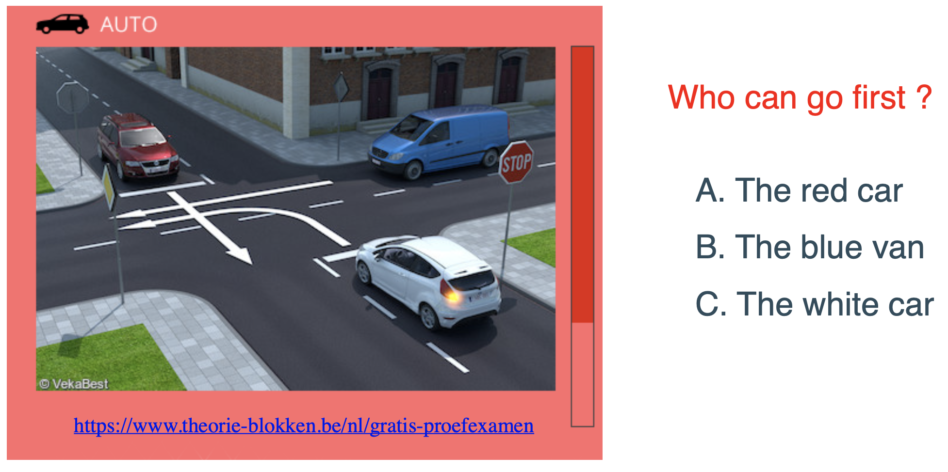
Real-life problems involve both aspects
Source: Luc De Reaedt’s talk in NS Summer School 2023

Slide 12
Formal Reasoning vs. Informal Reasoning
Formal reasoning is a systematic and logical process that follows a set of rules and principles, often used in mathematics and logic.
Informal reasoning is a less structured approach that relies on intuition, experience, and common sense to draw conclusions and solve problems, and is often used in everyday life.
Formal reasoning is more structured and reliable, while informal reasoning is more adaptable and open-ended, but may also be less reliable

Slide 13

Natural Language Reasoners
Bob has 8 candies, he bought 4 more and distributed equally among 3 kids. How many candies will each kid get?
bob_candy = 8
candies_bought = 4
num_kids = 3
each_kid_candy = ?
each_kid_candy = 4
Each kid will get 4 candies.
Semantic parsing
Natural Language Generation
Reasoning
LLM Blackbox
Source: Abulhair Saparov presentation at neuro-symbolic AI summer school 2023

Slide 14
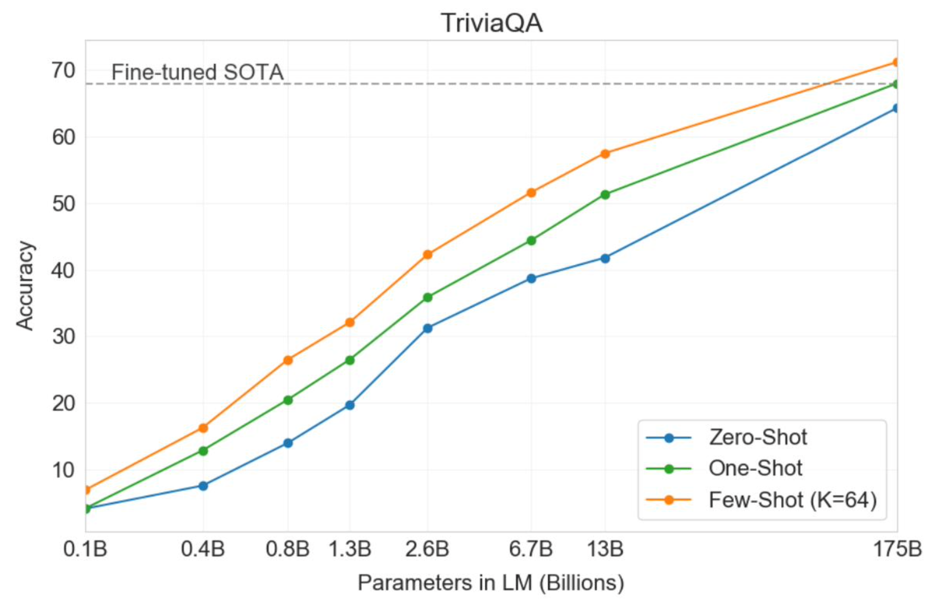
In-Context Learning (ICL) / Few-Shot Prompting
Few-shot prompting improves accuracy over zero-shot prompting. [Brown et al 2020]
Example of a zero-shot prompt:
“21 + 7 =”
Example of a 4-shot prompt, with 4 in-context examples: “13 – 2 = 11
6 * 4 – 3 = 21
8 / 2 + 8 = 12
6 – 7 + 4= 3
21 + 7 =”
Source: Abulhair Saparov presentation at neuro-symbolic AI summer school 2023

Slide 15
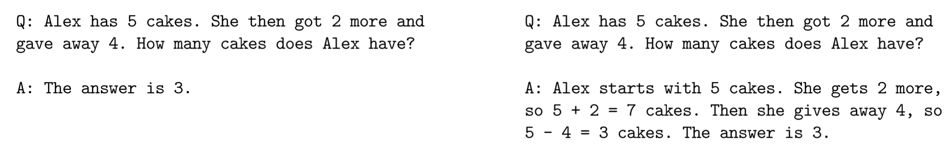
Chain of Thought (CoT) Prompting
Standard prompting do not perform well on complex reasoning tasks
Arithmetic reasoning
Commonsense reasoning
Symbolic reasoning
CoT prompting improves the reasoning ability
Incorporates intermediate reasoning steps
Natural language description of the step-by-step reasoning (i.e. proof)
Standard prompting Chain-of-thought prompting
CoT prompting is used in combination with few-shot prompting (or one-shot, or even zero-shot).
7
[Wei et al 2022] Chain-of-Thought Prompting Elicits Reasoning in Large Language Models, https://arxiv.org/pdf/2201.11903.pdf
Large Language Models are Zero-shot Reasoners, https://arxiv.org/pdf/2205.11916.pdf

Slide 16
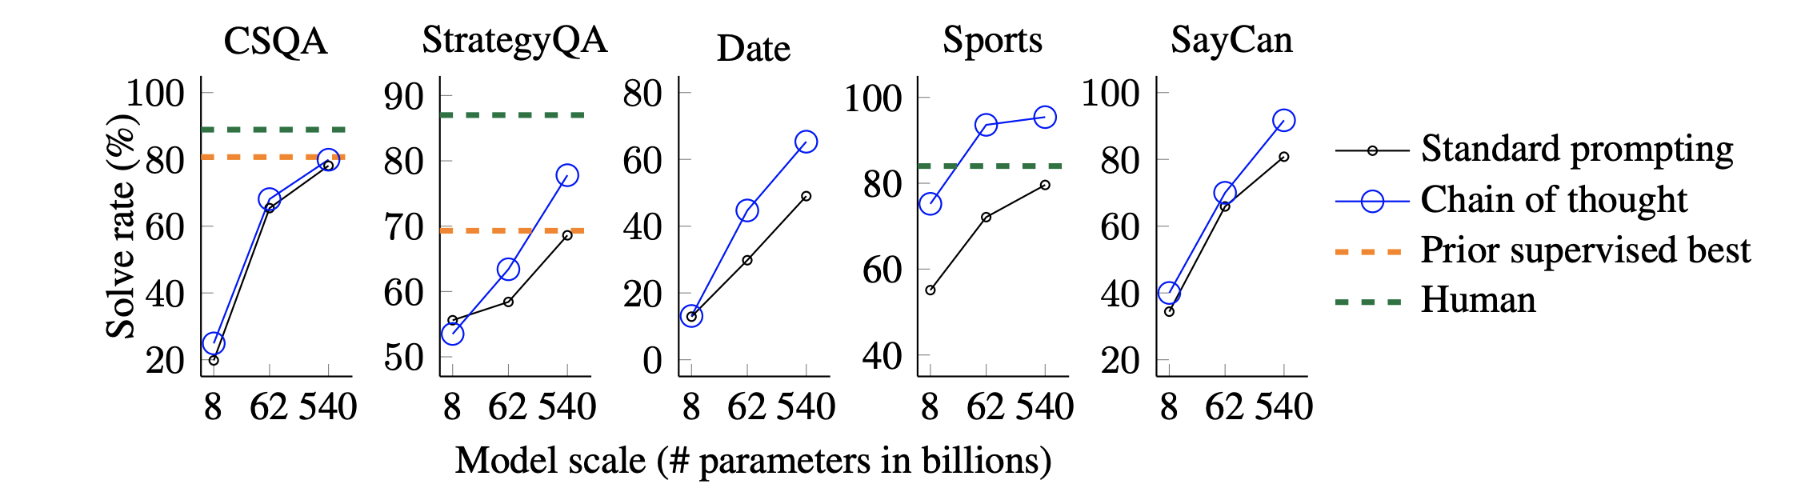
CoT Results
The reasoning ability of LLMs can be further enhanced with CoT prompting.
[Wei et al 2022]
CSQA: Commonsense questions about the world require prior knowledge.
StrategyQA: Multi-hop strategy to answer questions
Date: Inferring a date from a given context
Sports: Whether a sentence relating to sports is plausible or implausible.
SayCan: Mapping natural language instruction to a sequence of robot actions from a discrete set
benchmarks on commonsense reasoning

Slide 17
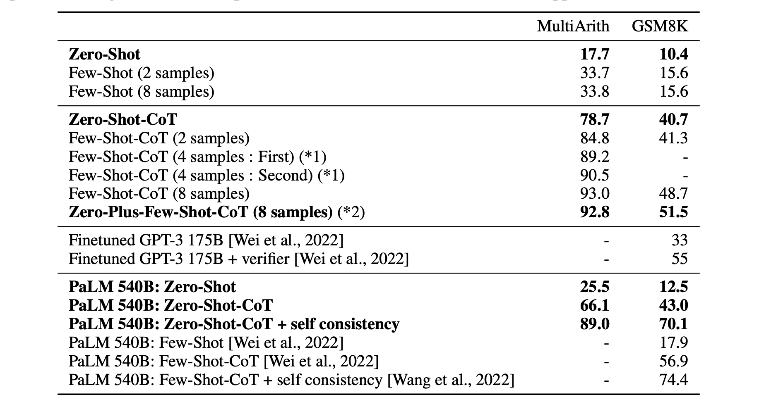
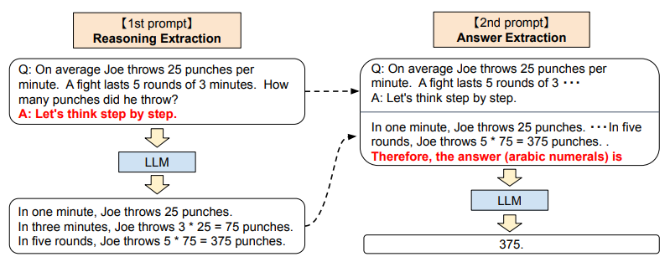
Zero-Shot CoT
Zero-Shot CoT results for text-davinci002 6B
Large Language Models are Zero-shot Reasoners (Jan 2023) -- https://arxiv.org/pdf/2205.11916.pdf

Slide 18
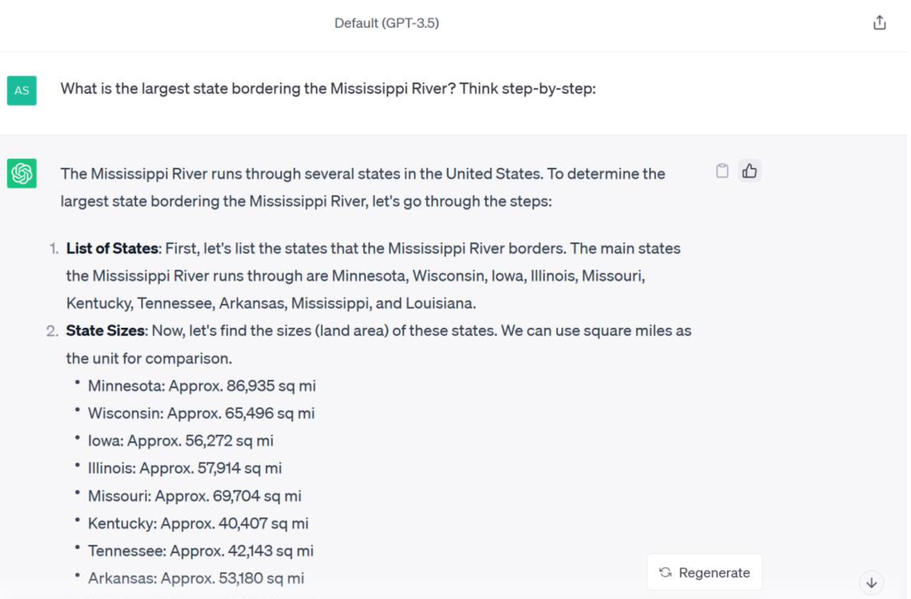
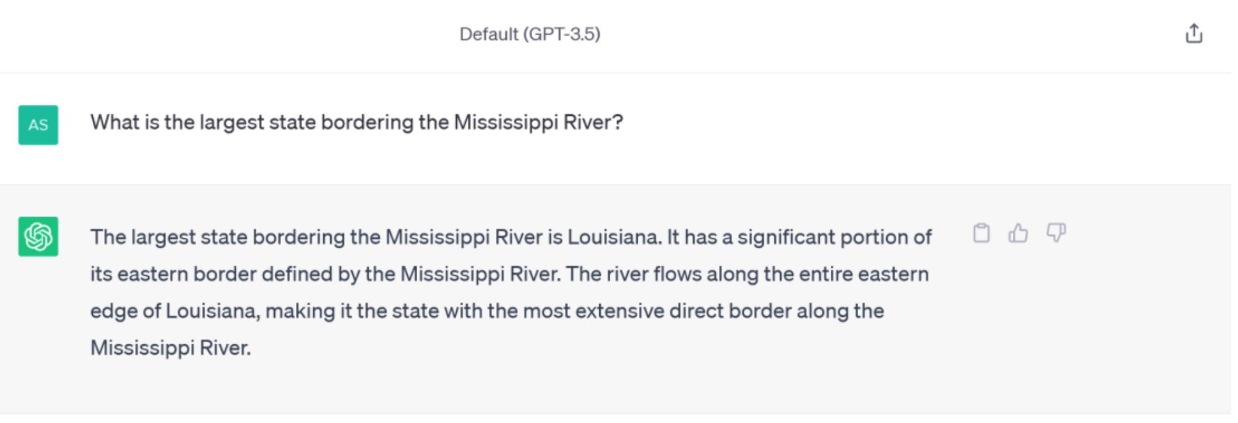
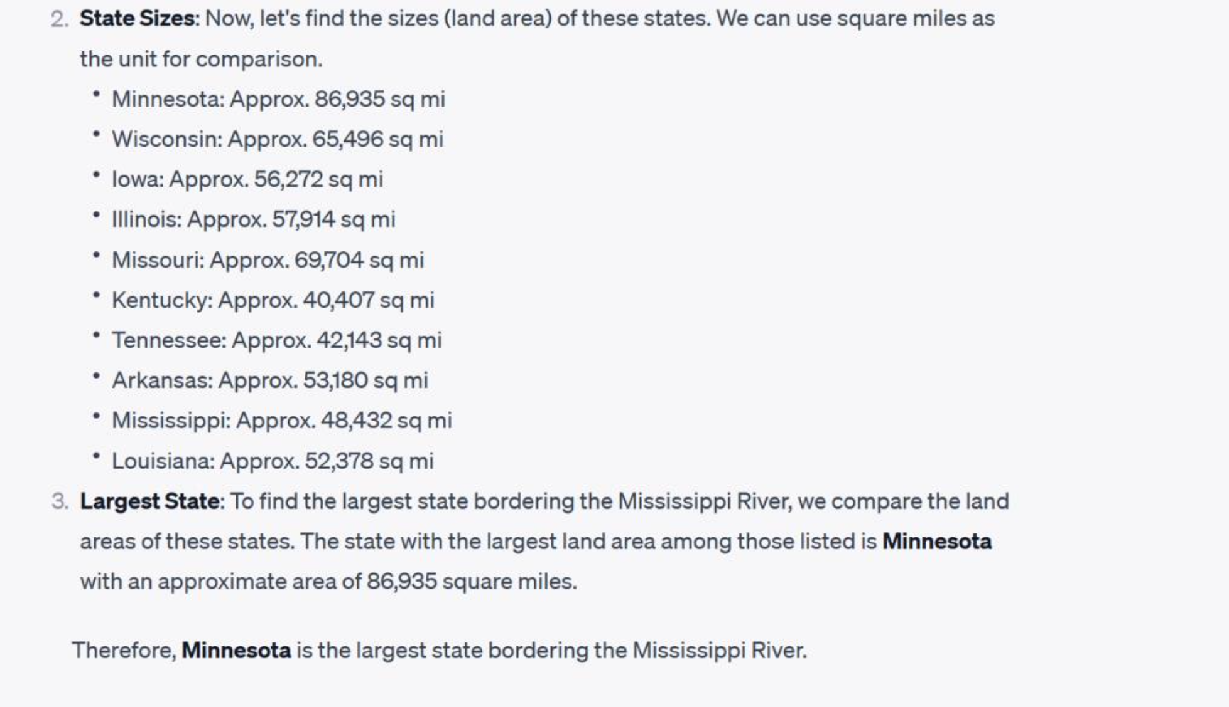
CoT Test on an LLM (ChatGPT)
[Kojima et al 2022]

Slide 19
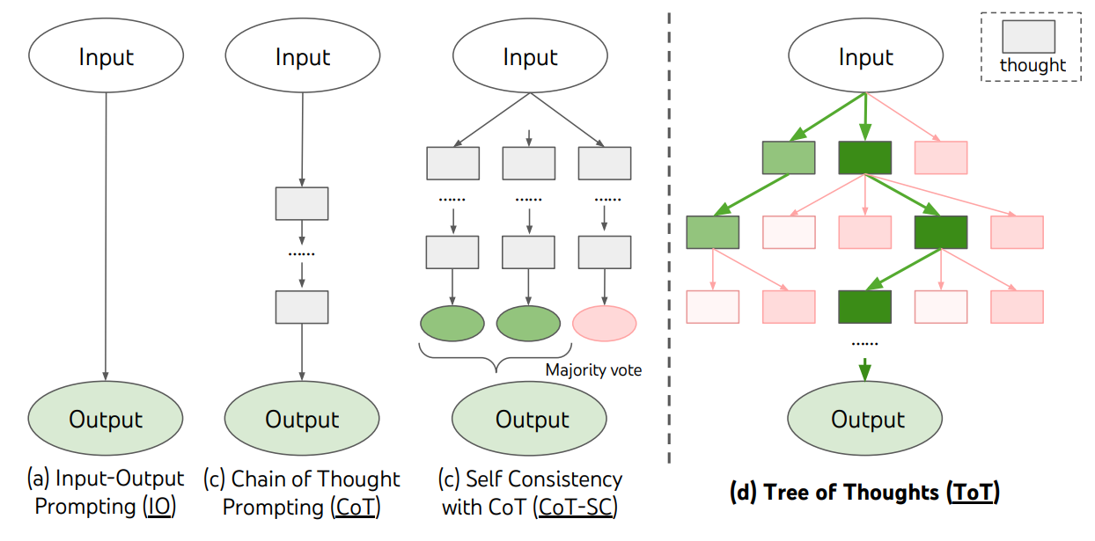
Tree of Thought (ToT) vs. CoT
Generate multiple thoughts
Critique on the thoughts
Prune lower quality paths
Backtracks when necessary
Shunyu Yao et al.
Tree of Thoughts: Deliberate Problem Solving with Large Language Models, 2023 (https://arxiv.org/abs/2305.10601)
Notes:
https://www.youtube.com/watch?v=ut5kp56wW_4&t=12s

Slide 20
HOW WELL ARE LLMS ABLE TO REASON?
The latest LLMs perform well on many datasets.
Sometimes they perform better than non-expert humans.
But does this imply that LLMs are able to reason?
There are many potential confounders:
Many existing benchmarks focus on the domain of math word problems.
Do benchmarks measure reasoning ability or retrieval ability?
E.g., A benchmark may ask the model to deduce a fact that is already known from pretraining.
The model may rely on shortcuts such as heuristics or spurious correlations.
Source: Abulhair Saparov presentation at neuro-symbolic AI summer school 2023

Slide 21




youtube.com/@asimmunawar
x.com/asimunawar
linkedin.com/in/asimmunawar
https://www.threads.net/@asimunawar
https://github.com/asimmunawar/ml-course
Asim Munawar

